Slide 1


MOHAN BABU UNIVERSITY
Sree Sainath Nagar, Tirupati – 517102
DEPARTMENT OF COMPUTER APPLICATIONS
Friends Circle Clustering in Online Social Networks Using Social Network Analysis
ROLL NO: 23102C010222
23102C010245
23102C010265
23102C010304
PROJECT SUPERVISER: Dr. Aaquib HussainGanai
NAME:
S.Ananya M.Sindhu M.Devipraveena N.C.Chithra Shree
BRANCH: Bachelor of computer applications
BATCH NUMBER:44 SECTION:(4,5)

Slide 2
ABSTRACT
Online social networks generate vast amounts of interaction data that reflect users’ relationships, interests, and communication patterns. Identifying meaningful friend circles within these networks is essential for understanding community structures, improving recommendations, and enhancing targeted services. This study presents a social network analysis–based approach for friends circle clustering in online social networks. The proposed method models users as nodes and their interactions as edges to construct a social graph, followed by the application of community detection and clustering algorithms to identify tightly connected groups. Key network metrics such as centrality, density, and modularity are used to analyze the strength and structure of relationships within each cluster. The approach helps uncover hidden communities, influential users, and interaction patterns that characterize social behavior. Experimental evaluation on representative social network datasets demonstrates that the proposed clustering technique effectively detects cohesive friend circles and improves the accuracy of community identification compared to traditional methods. The findings highlight the usefulness of social network analysis in organizing large-scale social data and supporting applications such as recommendation systems, information diffusion analysis, and personalized content delivery. Online social networks generate massive volumes of user interaction data, reflecting relationships, communication patterns, and shared interests. Identifying meaningful friend circles within such networks is a challenging task due to the complexity and scale of the data. This project presents an enhanced approach for friend circle clustering using Social Network Analysis (SNA) technique. In the proposed system, users are represented as nodes and their interactions as edges to construct a social graph. Advanced community detection algorithms such as the Louvain method and clustering techniques like K-Means are applied to identify closely connected groups. Important network metrics including degree centrality, betweenness centrality, and modularity are utilized to analyze the strength of relationships and to detect influential users within each cluster.
Keywords: Louvain Method, K-Means Clustering, Centrality Measures ,Modularity, Network Analysis, Graph Theory.

Slide 3
Contents
Introduction
Review of Literature
Proposed System
Execution
Results
conclusion
References

Slide 4
Introduction
Online Social Networks (OSNs) have become an integral part of modern communication, enabling users to connect, share information, and interact with others across the globe. Platforms such as Facebook, Instagram, and Twitter generate vast amounts of data through user activities like friendships, messages, likes, and comments. This data reflects complex relationships and interaction patterns among users.
Analyzing such large-scale social data is essential to understand how users form groups or communities. One important task in this domain is friend circle clustering, which focuses on identifying groups of users who are closely connected or share similar interests. However, due to the increasing size and complexity of social networks, detecting meaningful communities becomes a challenging problem.
Social Network Analysis (SNA) provides effective techniques to study and model these relationships by representing users as nodes and their interactions as edges in a graph. By applying graph-based methods and clustering algorithms, it is possible to uncover hidden communities, identify influential users, and analyze user behavior patterns.

Slide 5
Review of Literature
M. E. J. Newman (2006) introduced the concept of modularity, which is widely used to measure the quality of community structures in networks. His work laid the foundation for evaluating clustering performance in social graphs.
Blondel et al. (2008) proposed the Louvain algorithm, a fast and efficient method for detecting communities in large-scale networks. It is widely used due to its high scalability and ability to maximize modularity.
Girvan and Newman (2002) developed the Girvan–Newman algorithm, which detects communities by progressively removing edges with high betweenness centrality. This method is effective but computationally expensive for large networks.
U. N. Raghavan et al. (2007) introduced the Label Propagation Algorithm (LPA), which identifies communities
based on node labeling and propagation. It is simple and fast but may produce unstable results.
Recent studies (2024–2025) focus on machine learning and deep learning techniques for community detection, improving accuracy and handling dynamic and large-scale social networks.

Slide 6
Proposed System
The proposed system is designed to efficiently identify and cluster friend circles in online social networks using Social Network Analysis (SNA) techniques. It focuses on modeling user interactions as a graph and applying advanced community detection algorithms to discover meaningful groups.
Data Collection Module
Collects user data such as profiles, connections, and interactions from social network datasets.
Data Preprocessing Module
Cleans and filters the data by removing noise, duplicate entries, and inactive users to ensure accuracy.
Graph Construction Module
Converts the processed data into a graph structure where nodes represent users and edges represent relationships. Edge weights may be assigned based on interaction strength.

Slide 7
Execution
Data Collection → Data Preprocessing → Graph Construction → Network Analysis → Community Detection → Visualization → Result Analysis
Data Collection
Collect user data like friendships, interactions, and profiles from social networks.
Data Preprocessing
Clean the data by removing duplicates, missing values, and inactive users.
Graph Construction
Convert data into a graph where nodes represent users and edges represent relationships.
Network Analysis
Calculate centrality measures to identify important and influential users.
Community Detection
Apply algorithms like Louvain and K-Means to identify friend circles.
Visualization
Display the social network graph with clusters using different colors.
Result Analysis
Evaluate clusters using metrics like modularity and identify key users.

Slide 8
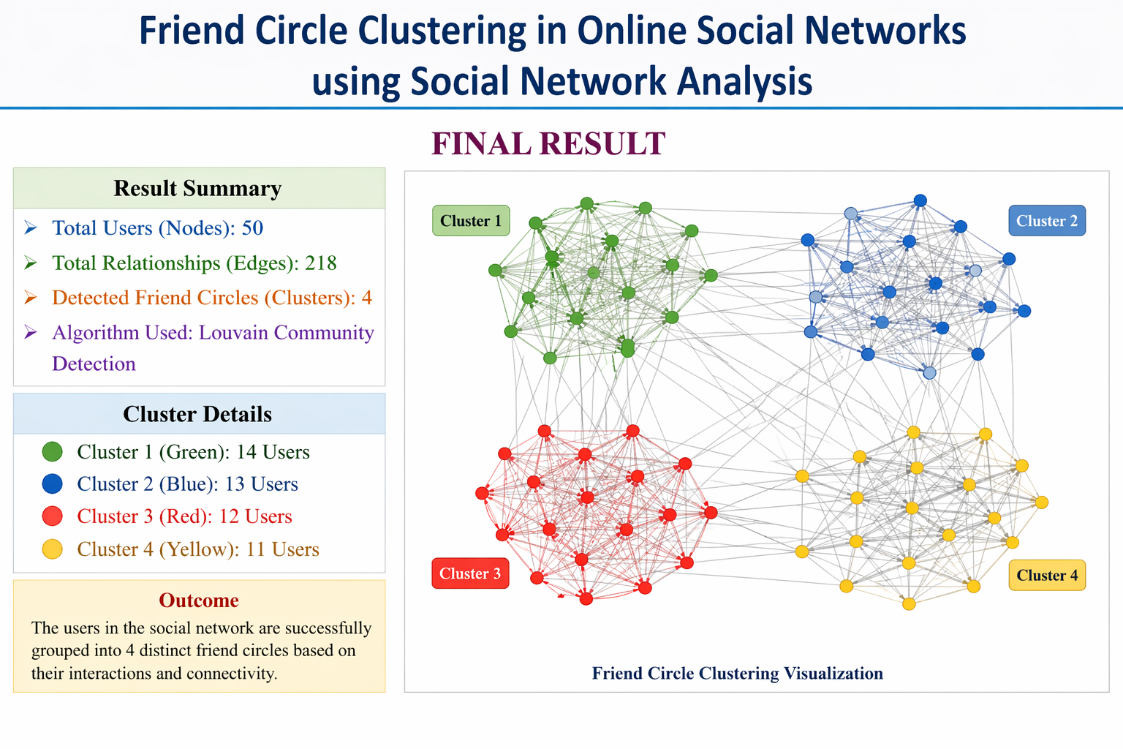
Results

Slide 9
Conclusion
This project presented an effective approach for identifying friend circles in online social networks using Social Network Analysis (SNA). By representing users as nodes and their interactions as edges, a social graph was constructed to analyze relationships and community structures.
The proposed system applied community detection algorithms such as the Louvain method along with clustering techniques to identify closely connected user groups. Network metrics like centrality measures and modularity were used to evaluate the strength of relationships and to detect influential users within each cluster.
The results demonstrate that the system successfully identifies meaningful friend circles with improved accuracy and efficiency compared to traditional methods. Visualization of the social graph further helped in understanding the structure of the network and the interaction patterns among users.

Slide 10

References
M. E. J. Newman, “Modularity and community structure in networks,” Proceedings of the National
Academy of Sciences (PNAS), vol. 103, no. 23, pp. 8577–8582, 2006.
Modularity and community structure in networks
Vincent D. Blondel, J.-L. Guillaume, R. Lambiotte, and E. Lefebvre, “Fast unfolding of communities in large networks,” Journal of Statistical Mechanics: Theory and Experiment, 2008.
https://arxiv.org/abs/0803.0476
Michelle Girvan and M. E. J. Newman, “Community structure in social and biological networks,”
Proceedings of the National Academy of Sciences (PNAS), vol. 99, no. 12, pp. 7821–7826, 2002.
Community structure in social and biological networks
Usha Nandini Raghavan, R. Albert, and S. Kumara, “Near linear time algorithm to detect community
structures in large-scale networks,” Physical Review E, vol. 76, no. 3, 2007
https://arxiv.org/abs/0709.2938
Recent Advances:
M. Nooribakhsh, M. Fernández-Diego, and F. González-Ladrón-de-Guevara, “Community detection in social networks using machine learning: A systematic mapping study,” Knowledge and Information Systems, vol. 66, pp. 7205–7259, 2024.
https://link.springer.com/article/10.1007/s13278-025-01519-7

Slide 11


